Slide 1

ONLINE PAYMENT FRAUD DETECTION

Slide 2

ABSTRACT
Online fraudulent transactions are a significant criminal violation. Every year, it costs people and financial institutions billions of dollars. It emphasizes the crucial importance of financial institutions in detecting and preventing fraudulent acts. Machine learning algorithms provide a proactive way mechanism to prevent online transaction frauds with high accuracy. With the rise in fraud rates, machine learning approaches can be used to identify and evaluate fraud in online transactions. To identify online payment fraud with machine learning, we need to train a machine learning model for classifying fraudulent and non-fraudulent payments. For this, we need a dataset containing information about online payment fraud, so that we can understand what type of transactions lead to fraud. For this task, I collected a dataset from Kaggle, which contains historical information about fraudulent transactions which can be used to detect fraud in online payments.

Slide 3
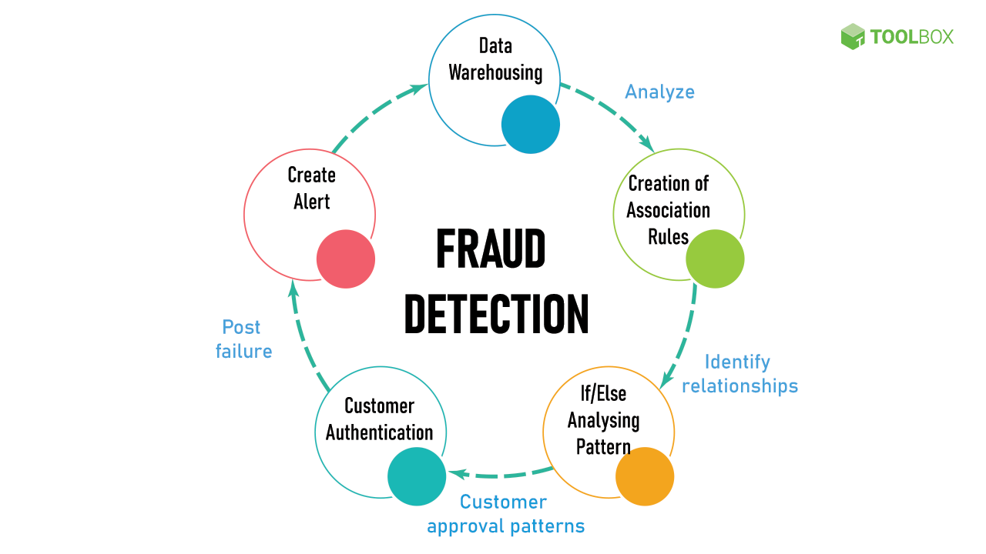
HOW IT IS HELPFUL TO PEOPLE
Fraud detection systems can identify suspicious activities and block unauthorized transactions, protecting individuals from losing money.
By detecting fraudulent activities early, businesses can avoid significant financial losses. Protecting customers from fraud helps maintain trust and a positive reputation.
Fraud detection systems use machine learning and artificial
intelligence to analyze user behavior and detect anomalies,
preventing fraud before it occurs.
EXISTING SYSTEM
The existing online payment fraud detection model relies on
the decision tree algorithm, which is a widely used supervised learning technique.

Slide 4
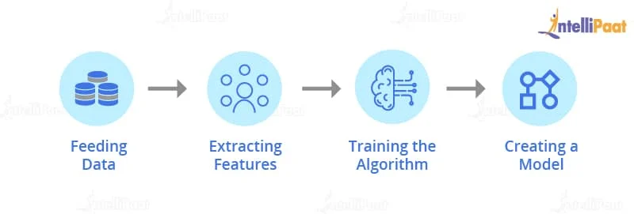
TRAINING OF MODEL

Slide 5
LIBRARIES
Pandas : This library helps to load the data frame in a 2D array format and has multiple functions to perform analysis tasks in one go.
Seaborn/Matplotlib: For data visualization.
Numpy : Numpy arrays are very fast and can perform large computations in a very short time.

Slide 6
Algorithms
Decision Tree Classifier : Decision Tree is a Supervised learning technique that can be used for both classification and Regression problems, but mostly it is preferred for solving Classification problems. It is a tree-structured classifier, where internal nodes represent the features of a dataset, branches represent the decision rules and each leaf node represents the outcome.

Slide 7
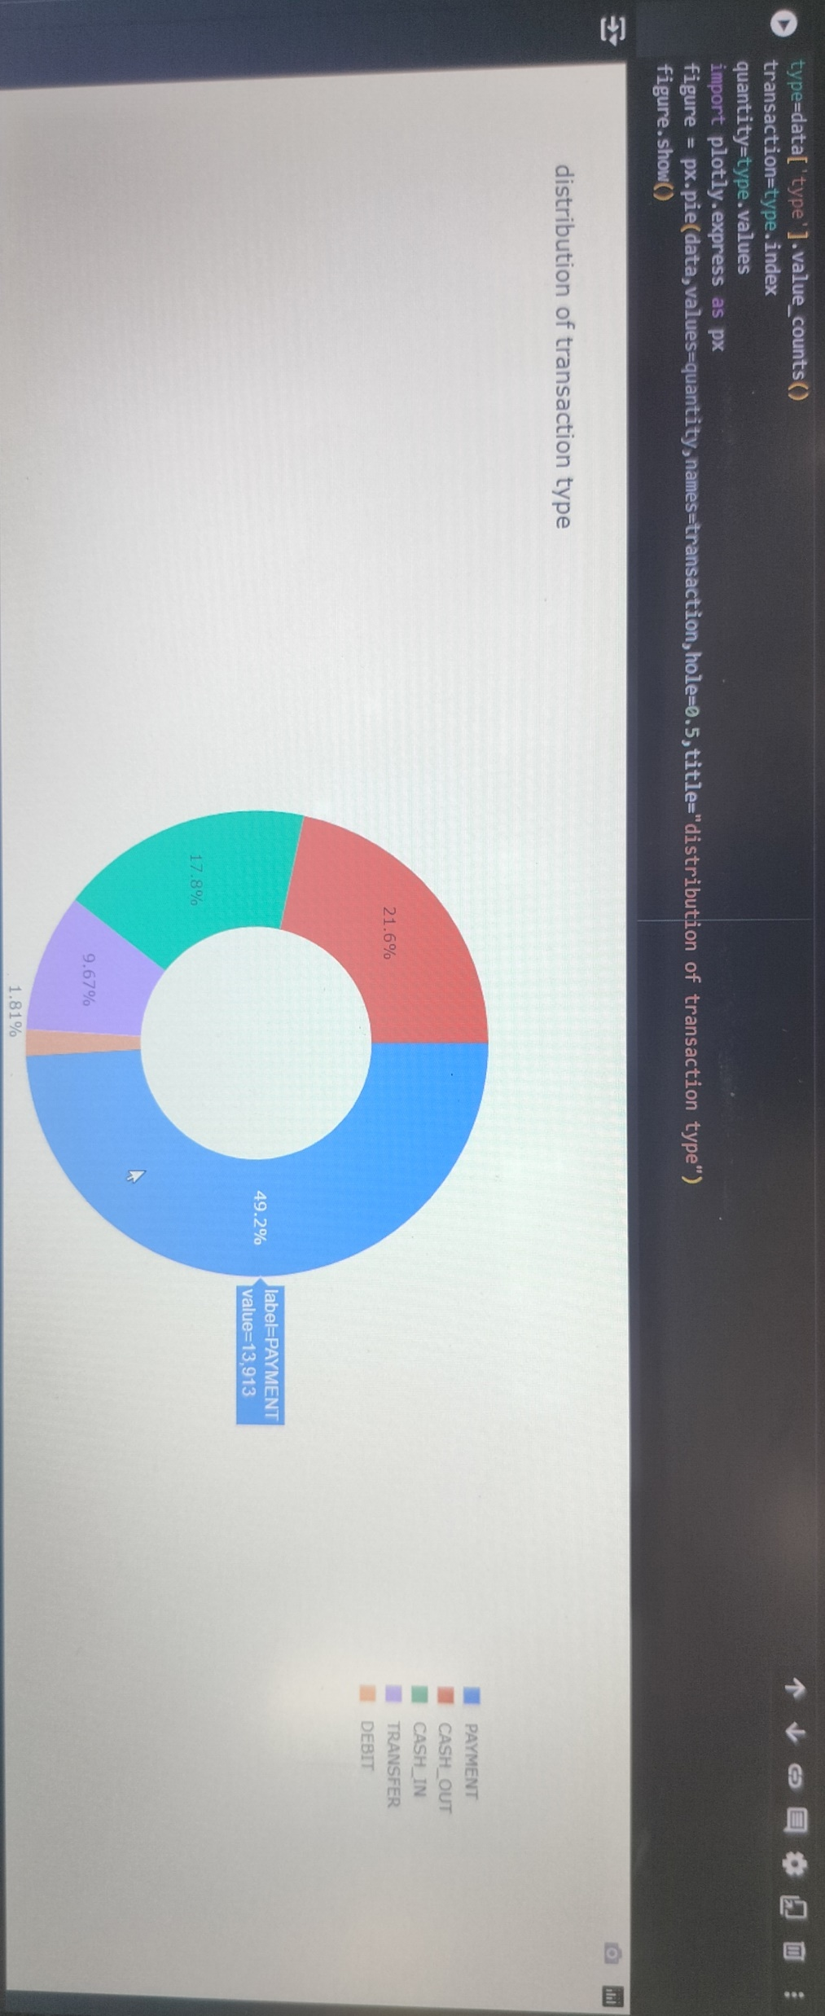

Slide 8
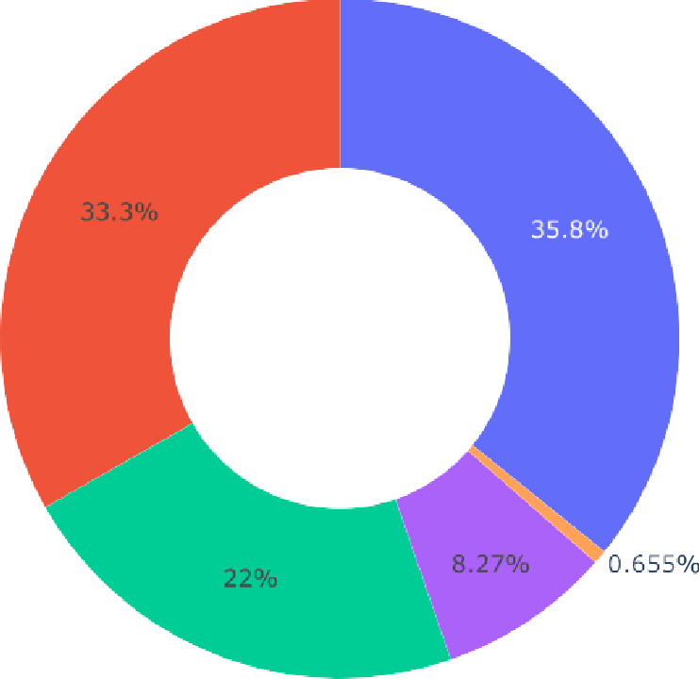
PIECHART
PAYMENT
CASH_OUT
CASH_IN
TRANSFER
DEBIT

Slide 9
CONCLUSION
`
We have large number of records which are incorrectly flagged as 0.
Incorrect flagging might have big impact in future if we don't calculate it properly as it might lead to
increase in online payment fraud percentage as people relay more on online payment nowadays.
The amount range usually fraudsters target is around 1-4 lakhs which is certainly a large sum.
Fraudsters focus during cashout and transfer mode type transfer.
Fraud is less likely/rare to happen during payment mode transfer though people are using online payment more.
We can conclude that by using decision tree algorithm we can detect the fraud and non-fraud payments. It helps for many people to save their money.

Slide 10
THANK YOU

